Slide 1
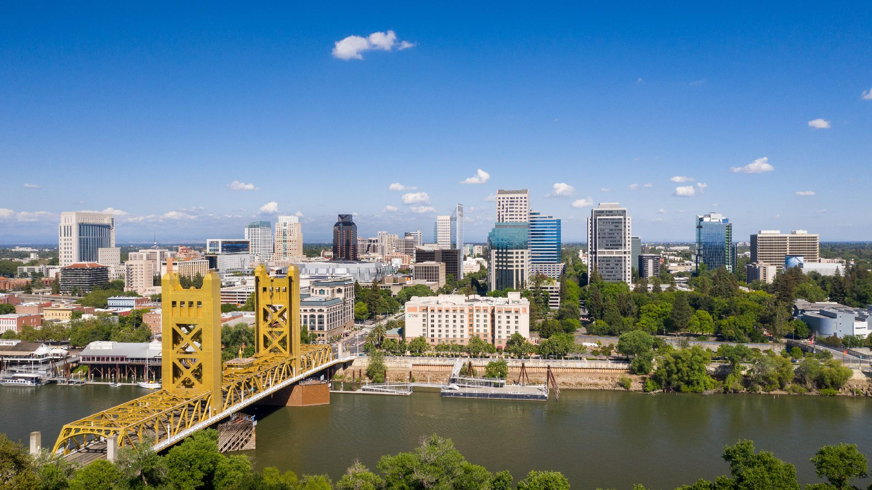
Selecting Optimal Location for Pizzeria Restaurant
in the Sacramento Region
Michael K. Christoff
January 2021

Slide 2
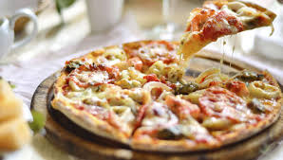
Introduction
Which regions of Sacramento would be an ideal spot for their new Pizzeria?
The ideal location
High traffic
Growing region
Minimize competition
Close to attractions
Cost of retail space not a factor
Ideal options to explore
Within city of Sacramento
Cities outside Sacramento

Slide 3
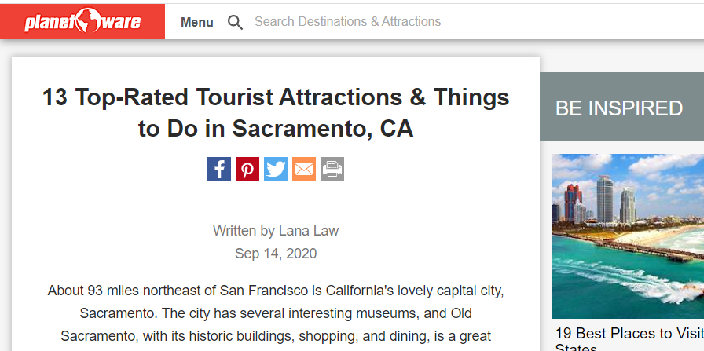
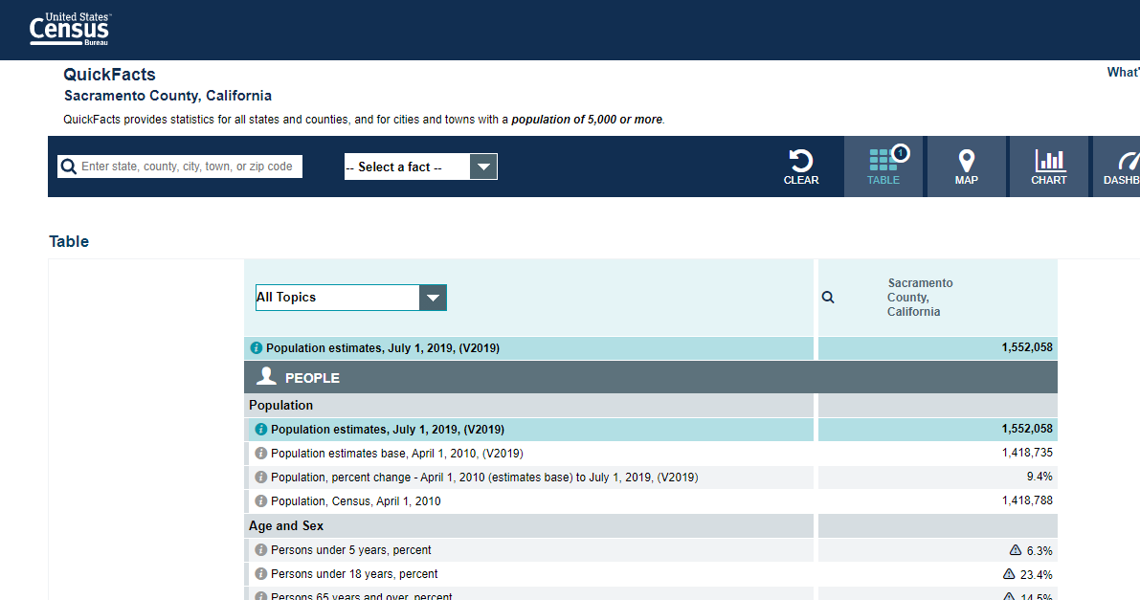
Data
Within city of Sacramento
planetware: 13 top-rated attractions within the city of Sacramento.
Venues within 500ft
Foursquare OSM location data
Notamatim geolocator tool
Cities outside Sacramento
largest cities within 2 hour drive
U.S. Census Bureau data on population and median family income
Venues within 1 mile
Foursquare OSM location data
Notamatim geolocator tool

Slide 4
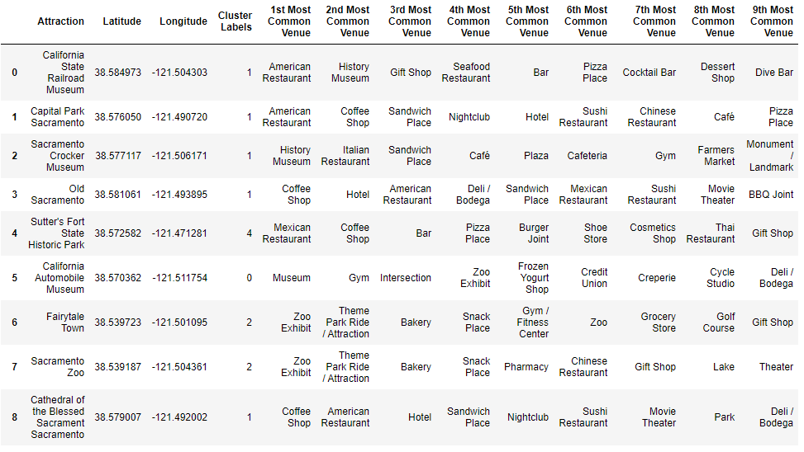
Methodology Within city of Sacramento, DataFrame

Slide 5
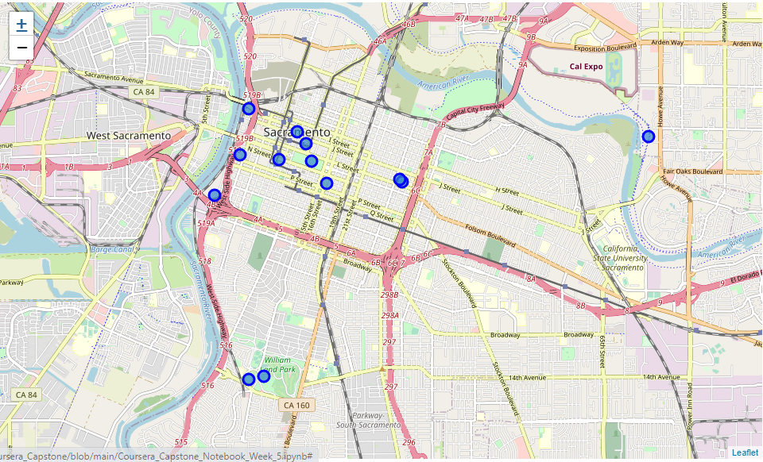
Methodology Within city of Sacramento, Folium map

Slide 6
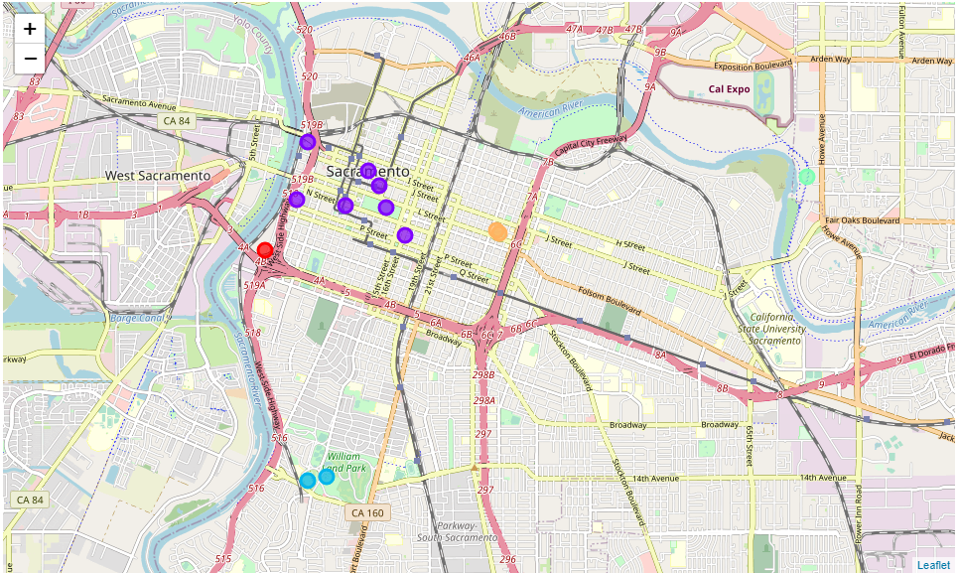
Methodology Within city of Sacramento, K-means clustered map

Slide 7
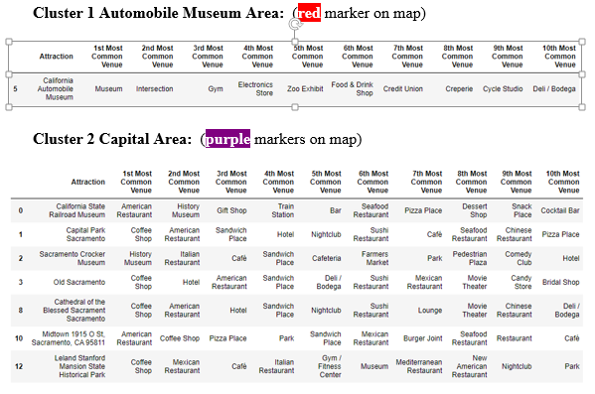
Methodology Within city of Sacramento, Clusters 1 & 2

Slide 8
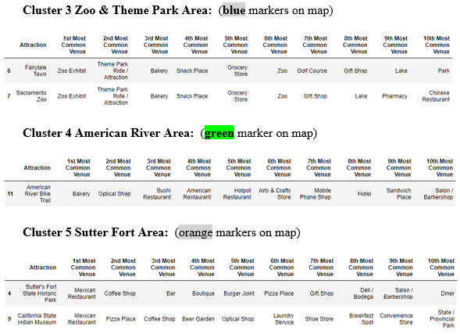
Methodology Within city of Sacramento, Clusters 3, 4 & 5

Slide 9
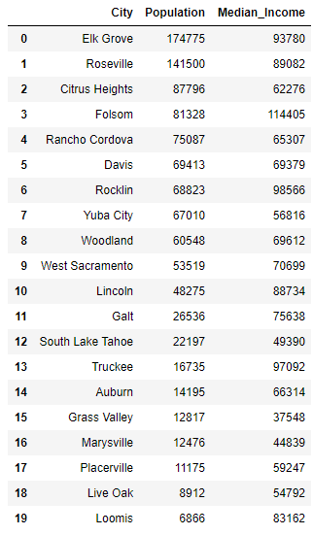
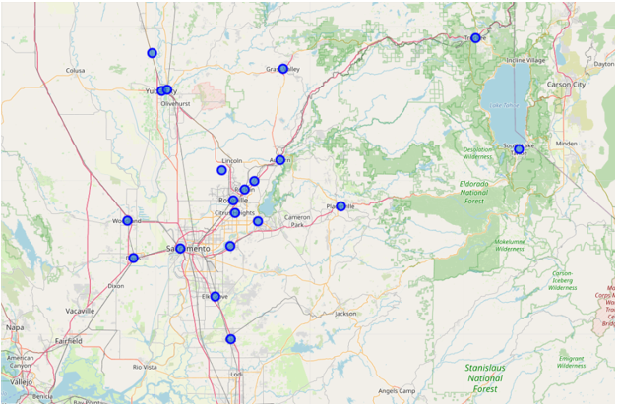
Methodology Cities outside Sacramento, DataFrame & Folium map

Slide 10
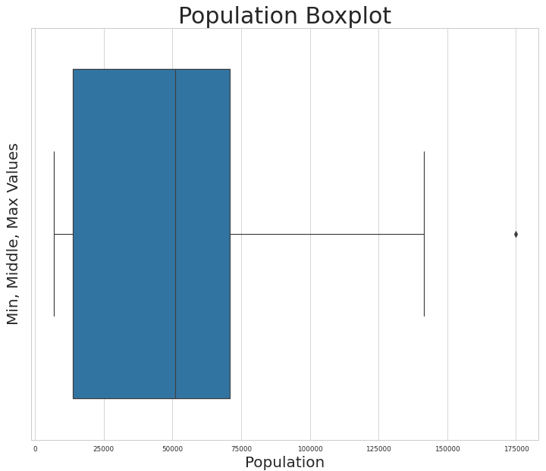
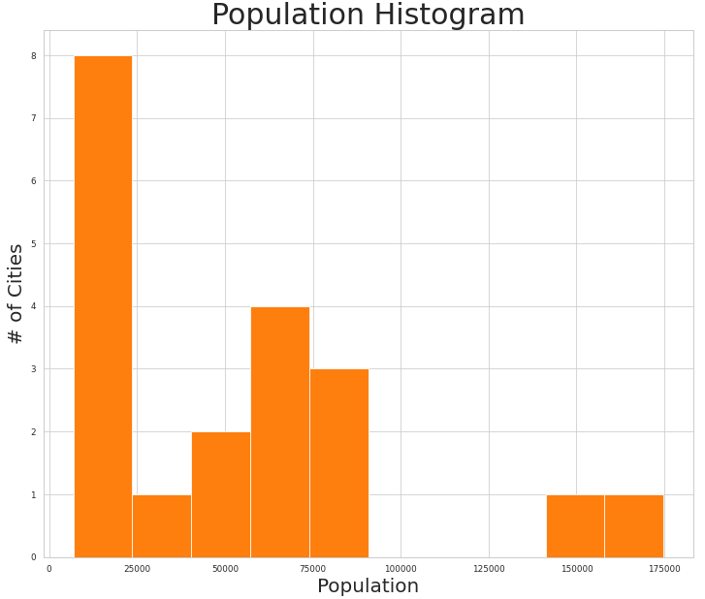
Methodology Cities outside Sacramento, Population Charts

Slide 11
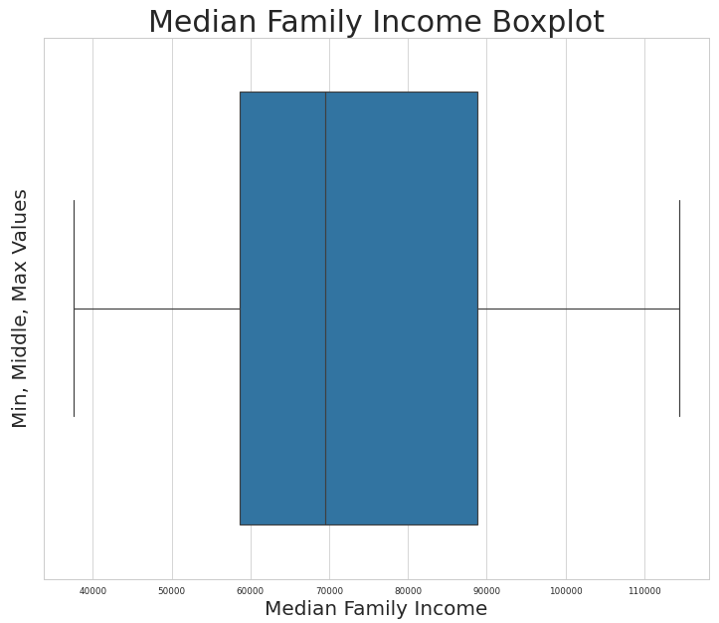
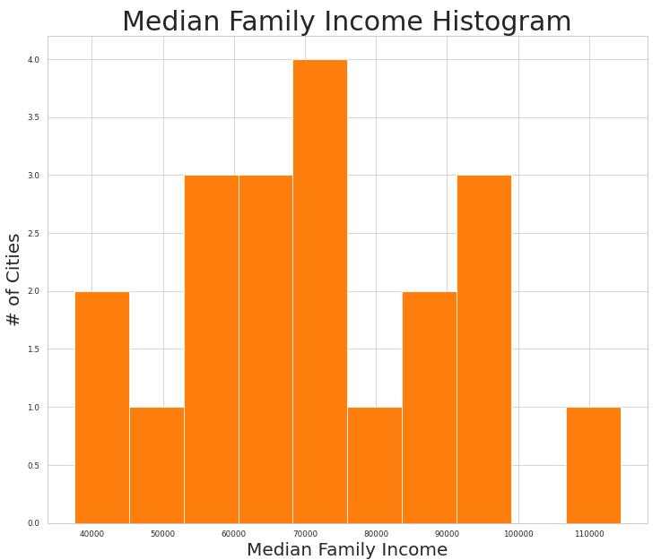
Methodology Cities outside Sacramento, Median Family Income Charts

Slide 12
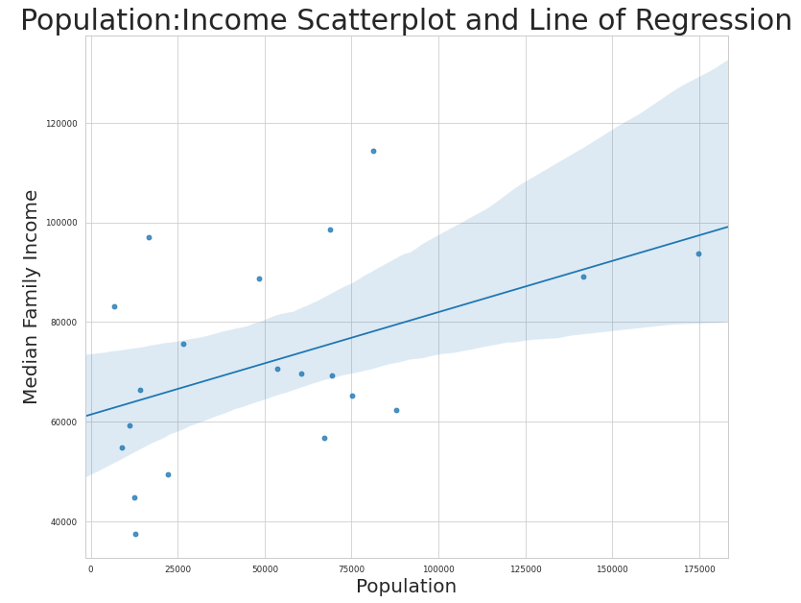
Methodology Cities outside Sacramento, Scatterplot Chart

Slide 13
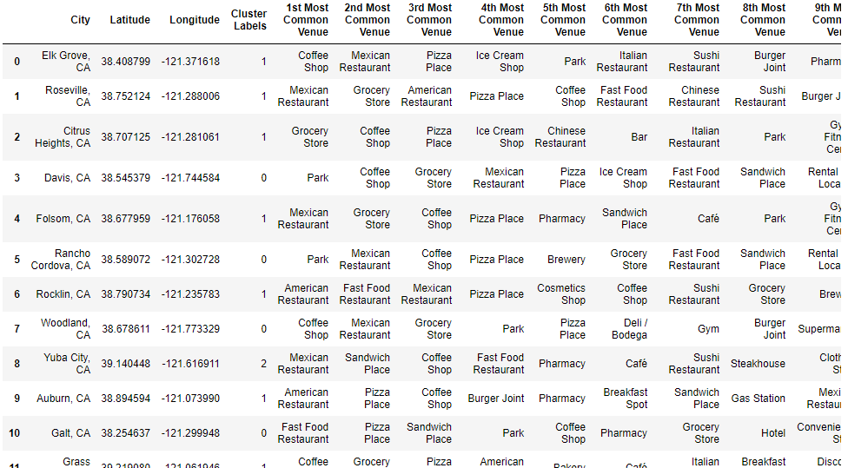
Methodology Cities outside Sacramento, K-means DataFrame

Slide 14
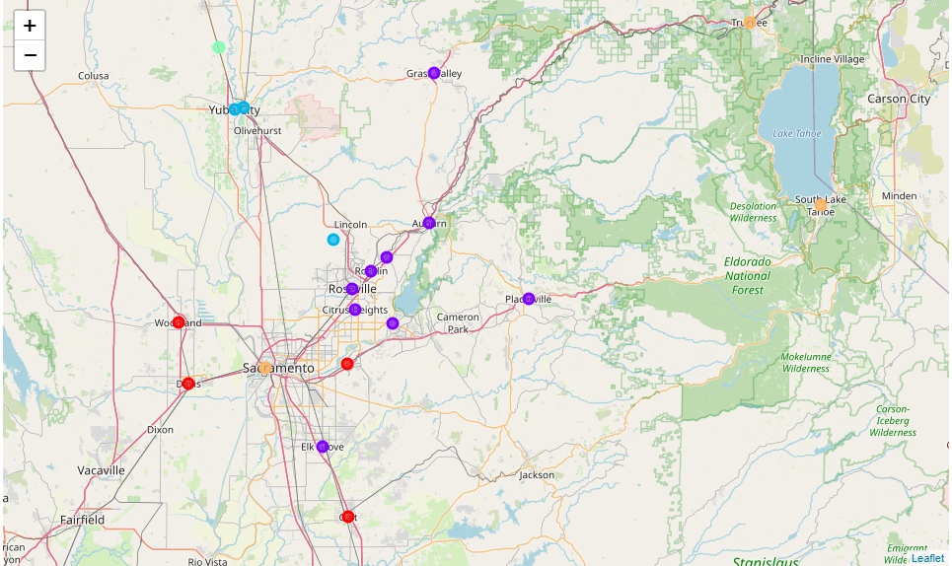
Methodology Cities outside Sacramento, K-means Clustered map

Slide 15
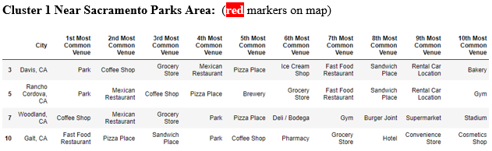
Methodology Cities outside Sacramento, Cluster 1

Slide 16
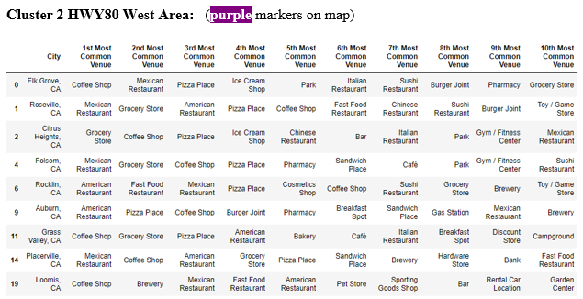
Methodology Cities outside Sacramento, Cluster 2

Slide 17
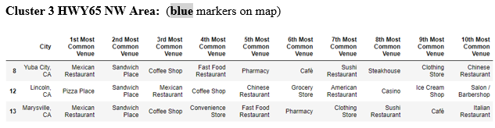
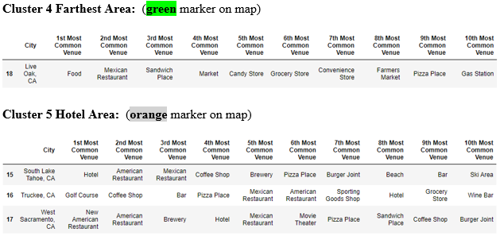
Methodology Cities outside Sacramento, Cluster 3, 4 & 5

Slide 18
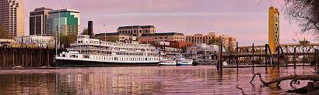
Results Within city of Sacramento
There were 545 venues and 120 unique venue categories found within 500 feet of all 13 attractions within the city of Sacramento.
Capital Park (97) and the Cathedral (69) contained the most unique venue categories, while the Automobile Museum (4) and Bike Trail (13) represented the least.
Cluster 2 Capital Area seemed to have the bulk of the neighborhoods closest to the city center, while the other clusters were outside the city center in areas with a lower number of unique vendor categories.
Three clusters (clusters 1, 3 and 4) did not contain Pizzerias within 500 ft. of the neighborhood center.

Slide 19
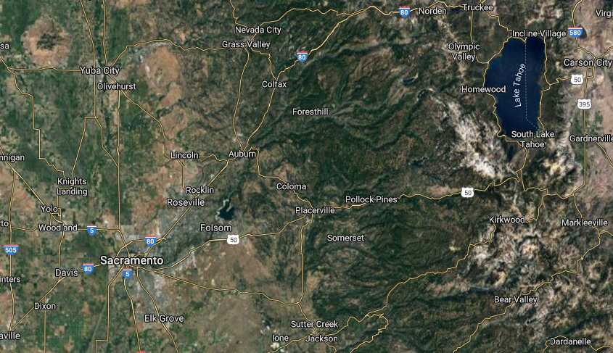
Results Cities outside Sacramento
1,671 venues and 219 unique venue categories within 1 mile of each of the 20 cities outside Sacramento.
There were 9 cities that reached the 100 search limit of unique venues within 1 mile, while Galt (41) and Live Oak (10) had the fewest.
Elk Grove (174,775) and Roseville (141,500) had the highest population while Live Oaks (8,912) and Loomis (6,866) had the least.
Folsom (114,405), Elk Grove (93,780) and Rocklin (98,566) had the highest median family income while Grass Valley (37,548) and Marysville (44,839) had the least.
The majority of median family income was between just under $60,000 and just under $90,000, with the full range from $37,548 to $114,405.
Median family income between just under $60,000 and just under $90,000, with the full range from $37,548 to $114,405.
Populations between just under 25,000 and just under 75,000, with the full range from 6,866 to 274,775.
Eight (8) cities in the results with less than 25,000 population.
Positive correlation between population and median family income

Slide 20
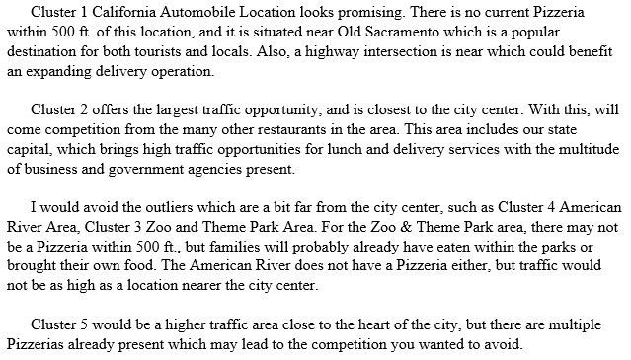
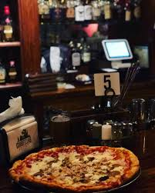
Discussion Within city of Sacramento

Slide 21
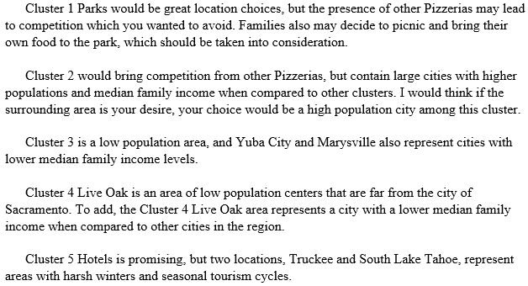
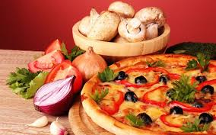
Discussion Cities outside Sacramento

Slide 22
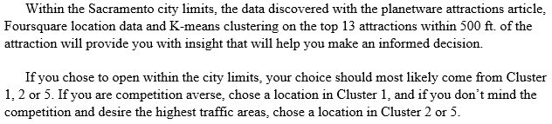
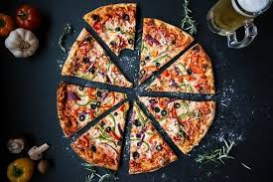
Conclusion Within city of Sacramento

Slide 23
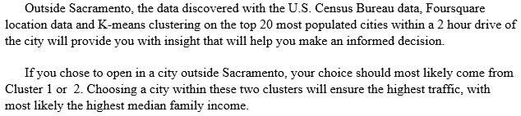
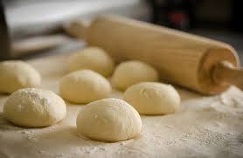
Conclusion Cities outside Sacramento

Slide 24
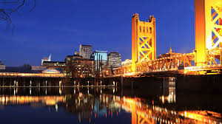
Slide 11
THANK YOU

